Slide 1
Putting Patents to Work for the World’s Poor
Chris Barrett
Dyson and Brooks Schools
Rose House Café
November 8, 2023

Slide 2
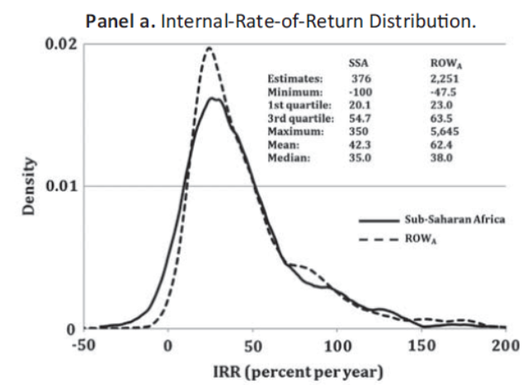
The unmet need for R&D for the poor
Massive unmet needs
Scant R&D targets neglected tropical diseases (NTDs), orphan crops (OCs) and other ills faced mainly by the poor:
dengue, schistosomiasis, trypanosomiasis, etc. 2.5-3.5 bn
cassava, cowpea, millets, plantain, tef, etc. >100 mn ha and cultivated by >500 mn poor farmers
Hence very high estimated ROI on such investments.
Example: IRR on (mostly multilateral/philanthropic) ag R&D investments averages
35-62 %/yr (Pardey et al. FP 2016)

Slide 3
Private capital remains on the sidelines
Huge inactive capital
Vast private capital on sidelines: S&P 500 companies hold $2.6 trillion in cash and liquid investment end-June (Apple alone has $167 bn) (Investor’s Business Daily Sep 19, 2023).
Those funds earn 2-5% annually.
That’s ~ 2 orders of magnitude > NTD/OC investment needs!
Q: Why the huge gap between low-return corporate cash holdings and underfunded high-return investments?
A: Small $ commercial market for discoveries for the poor.

Slide 4
IP economics
If R&D is expensive, it generates sunk costs. For R&D investment to be profitable, it must generate adequate profit in the post-discovery market.
(Temporary) monopoly power yields those gains.
Trade secrets offer one option.
Patents offer investors gov’t-protected monopoly power.

Slide 5
Economics of patents
If SC>A, no production occurs.
A is the monopoly rent.
Private returns to inventor = A/FC
Consumer gains = B during patent life
= A+B+C competitive mkt/post-patent
Price
B
Total Mkt
Demand
P^{monopoly}
A
C
Marg. Cost =
P^{competitive}
Units
0
Marginal Revenue

Slide 6
Economics of patents
Remember, If SC>A, no production occurs … likely for poor communities because demand is a function of income/wealth, so A falls dramatically (from A^{rich} to A*) for products for poor markets.
If poor people’s lives are equal in value to rich people’s, the difference in market-based potential causes the gap between private investment and social returns.
So find a way to apply rich mkt demand to discoveries that benefit poor people!
Price
Total Rich
Mkt Demand
A^{rich}
B*
P^{monopoly*}
A*
C*
Marg. Cost =
P^{competitive}
Units
Total Poor Mkt Demand
0
Marginal
Revenue

Slide 7
Strategy 1: Promise payments
Existing tools insufficient
Governments or philanthropies promise $ to boost demand.
Prizes: lump sum payment promised (AgResults)
Advance market commitments: guarantee min mkt size (GAVI)
Impact investments: payments for measurable performance, often based on future cost reductions
Probs: 1) time inconsistency
2) limited fundraising capacity
Result: Good but woefully insufficient

Slide 8
Strategy 2: Intellectual property rights
Existing tools insufficient
Some tools use IP, but not very effectively.
Humanitarian use licensing: can work to extend products for rich people (e.g., HIV/AIDS, COVID, cancer) but not for products aimed at poor people (NTDs/Ocs) and subject to technology mismatch problems on global tech.
Priority review vouchers: for 27 NTD/RDs grant a voucher to priority FDA review of another drug. But limited domain and duration, so max value to date $350mn.
Each tool can contribute but insufficient.

Slide 9
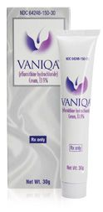
Lesson of eflornithine
Eflornithine (similar for ivermectin):
1970s development for cancer treatment (failed)
WHO adds to Essential Medicines List to treat advanced trypanosomiasis (‘sleeping sickness’)
Patent holder (Aventis) discontinued production b/c unprofitable
After several years’ unavailability, brought back into production once found effective to remove unwanted facial hair on women: Vaniqa.
Lesson: need a lucrative prospective market (e.g., cancer, hirsutitis) to elicit investment and a luxury product for the well-off can sustain it.
But don’t rely on serendipitous dual use discoveries!

Slide 10
Benevolent patent extensions
BPEs offer inventor of a ‘benevolent discovery’ the right to extend patent of some other, ‘non-essential’ IP conditional on
a ‘public use’ condition: attest they will not enforce or dedicate to public their patent right; and
Demonstration that discovery works but social returns far exceed commercial returns.
‘Benevolent discoveries’ have direct charitable rather than profit objectives.
Today, most BDs are open-source discoveries based on philanthropic or public R&D finance. Patent (or trade secret) incentives elicit few benevolent discoveries.

Slide 11
Benevolent patent extensions
For an invention that is non-obvious, novel, useful and benevolent
In filing for patent, a BD inventor can request the option to extend another, existing, likely unrelated, non-essential patent in exchange for satisfying the ‘public use’ condition.
PTO must assess (i) benevolence of invention, (ii) non-essentiality of patent to be extended, and (iii) value of BD and thus duration of BPE. If (i) and public use condition satisfied, then BPE request granted. BPE duration set based on social value of BD and the annual sales revenue of the non-essential patent to be extended.

Slide 12
What is non-essential?
Only ‘non-essential’ patents eligible for extension.
Any patent essential to maintain healthy, active life ineligible for extension. So not vaccines, life-saving devices/drugs, transport safety equipment, etc.
Examples of eligible patents: business software, sporting goods, leisure/entertainment goods and designs, cosmetics, male baldness or erectile dysfunction treatments, etc.
Target: high-value luxury lifestyle products/designs
(ideally w/ very income elastic / price inelastic demand)

Slide 13
Key implications
Value boost: BD valued based per non-essential extended patent, not on BD’s direct mkt value.
Voluntary: No inventor obliged to surrender patent rights. No consumer obliged to pay monopoly premia.
Accelerated availability: Inventor retains (but cannot enforce) IP. Generic producers of BD can enter right away.
Progressively redistributive: Transfer from CS of purchasers of patented product beyond original expiration to CS of BD users and PS of BD inventors.
Prospective investors: non-practicing entities; cash-rich digital tech firms; firms needing image boost.

Slide 14
Possible benefits
Induced R&D capacity in Global South:
Benevolent discoveries often require in situ R&D: Subject populations for human trials; agroecological conditions for crop trials; accessions of wild native species from which to draw genetic material; etc.
Encourage investment in R&D facilities and human capital: Much of Global South deficient in both.
If a big tech firm wants to extend app patent, a strategy becomes to invest in labs in LMICs.

Slide 15
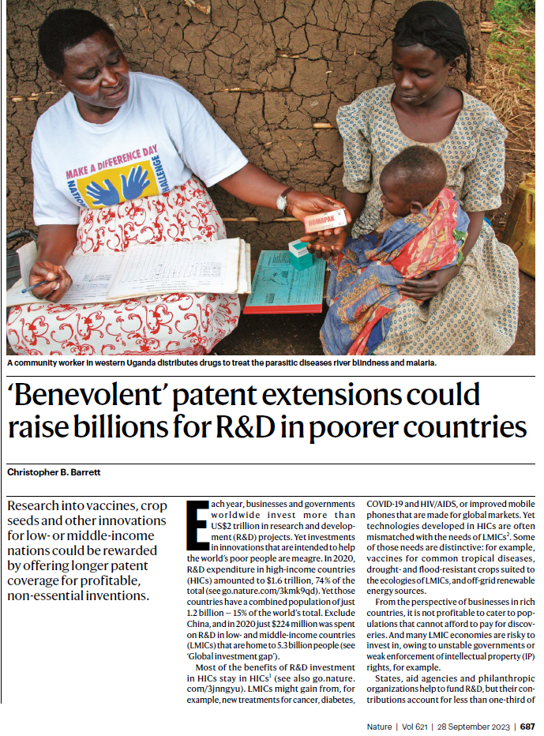
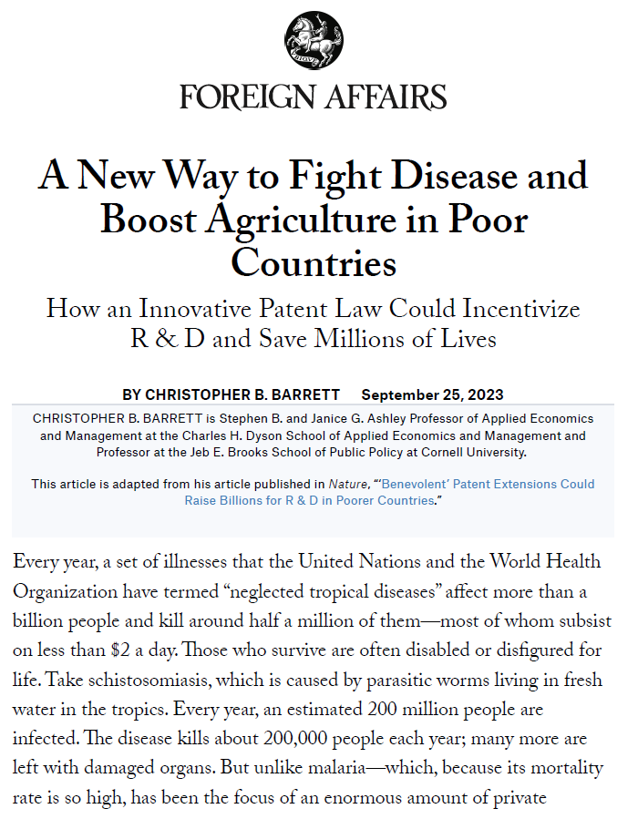
For more details
Sep 25, 2023 issues of

Slide 16
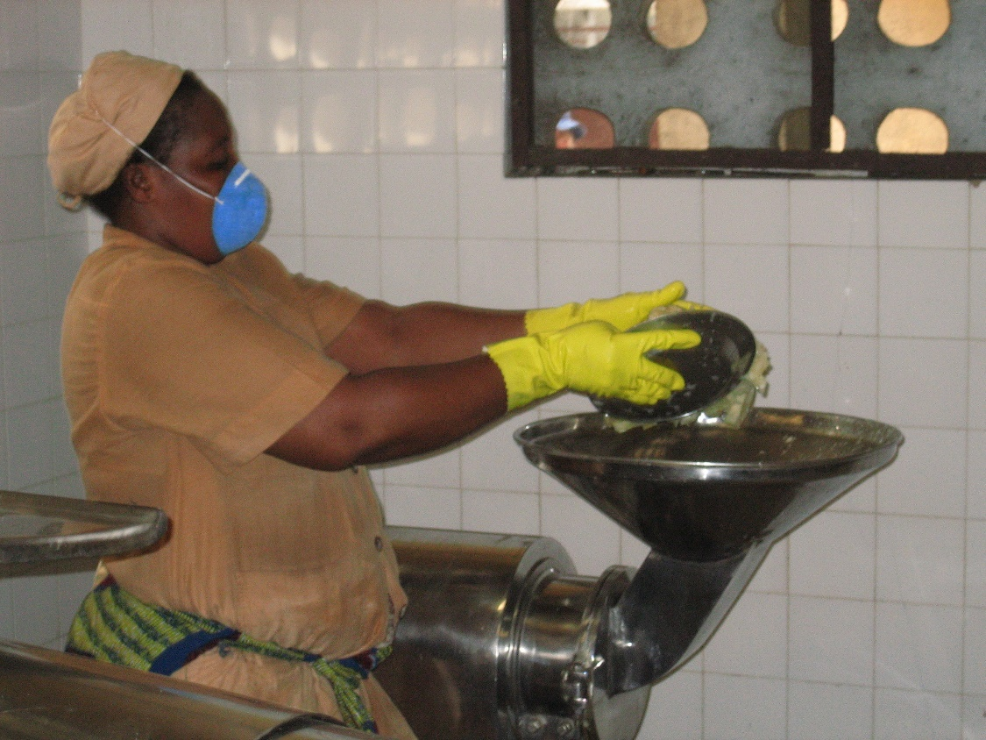
Thank you
Thank you for your interest
I invite your comments

